Slide 1

Phishing URL
Detection
Amit Mondal

Slide 2
Presentation Outline
PRE-PROCESSING
Feature Engineering
and EDA
BACKGROUND
Deﬁnition, History,
Impacts
CONCLUSIONS
Final Thoughts and
Recommendations
Ten Models Tested,
Deployment in Streamlit
Application
MODELING &
DEPLOYMENT
Dataset Descriptions
DATA COLLECTION

Slide 3

BACKGROUND

Slide 4

What is phishing?
Phishing is a form of cybercrime in which a target is contacted via email, telephone, or text message by an attacker disguising as a reputable entity or person. The attacker then lures individuals to counterfeit websites to trick recipients into providing sensitive data.
The purpose of this project is to help individuals identify these phishing URLs in order to provide safer practices online.

Slide 5

Types of Phishing Tactics
96% of phishing attacks arrive by email.
Email
Telephone
Text
Message
3% of phishing attacks is done over the telephone.
This is also known as vishing.
1% of phishing attacks is done via text message.
This is also known as smishing.
Source: www.tessian.com

Slide 6
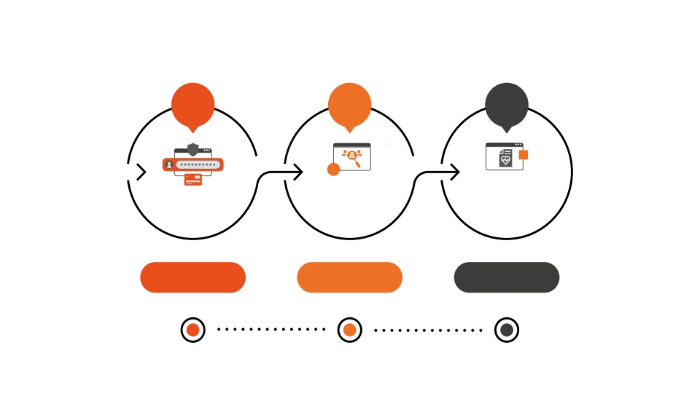
Top Three Types of Data
Name, address,
email address
PERSONAL DATA
Treatment
information,
insurance claims
MEDICAL
Passwords, usernames,
pin numbers, credit
card information
CREDENTIALS
Source: Verizon’s 2021 Data Breach Investigations Report

Slide 7
History of Phishing
Phishers impersonate AOL
employees using AOL messenger
and phishing emails to have users
“verify” personal information.
Mid-1990s
In 2001
Attackers turn to ﬁnancial systems, ﬁrst launching attacks on the digital currency site E-Gold.
Slight domain variations of legitimate sites, like eBay and PayPal, are created. Phishing emails are sent asking customers to visit the sites providing their credit card.
By 2003
In 2020
Google ﬂags an average of 46,000 phishing sites per week, nearly a 20% increase from 2019. Researchers say the COVID-19 pandemic is to blame.

Slide 8
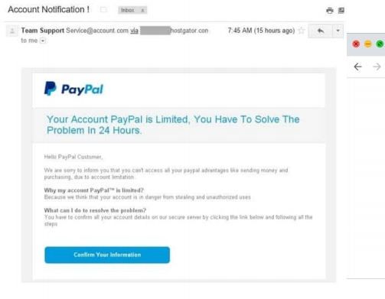
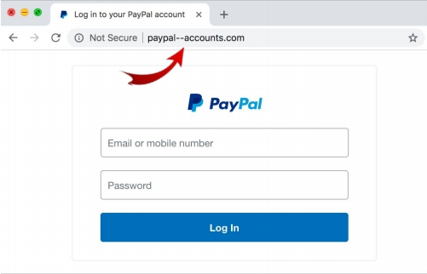

Paypal

Slide 9

2021 Phishing Statistics
30% of phishing emails are opened by users, and
12% of these targeted
users click on the
malicious link or
attachment.
97% of the users are unable to recognize a
sophisticated phishing
email.

Slide 10
Common Features of Phishing Emails
Too Good to
Be True
Sense of
Urgency
Hyperlinks
Unusual
Sender
Source: www.phishing.org

Slide 11

Common Subject Lines in Phishing Emails
(Q4 of 2020)
COVID-19 Remote
Work Policy Update
Changes to your
health benefits
Google Pay:
Payment sent
Stimulus
Cancellation
1
2
5
6
Request Approved
Zoom: Scheduled
Meeting Error
Company Policy
Notification:
COVID-19 - Test &
3
7
Trace Guidelines
Twitter: Security
alert: new or
unusual Twitter
Vacation Policy
Update
4
8
login
Source: www.knowbe4.com

Slide 12
According to the FBI, phishing incidents nearly doubled in frequency, from
114,702 incidents in 2019, to 241,324
incidents in 2020. The increase in remote
work could be to blame.
As the internet becomes a major mode for
economic transactions and
communications, online trust and
cybercrimes have increasingly become an
important area of study.

Slide 13
MACHINE LEARNING ALGORITHMS

Slide 14
1. Logistic Regression:
Logistic Regression is a popular and widely used algorithm for binary classification problems. It models the relationship between the input features and the probability of a certain class using the logistic function. It is suitable for problems where the decision boundary is linear or can be approximated by a linear function. Logistic Regression is computationally efficient, interpretable, and can handle large datasets. It is particularly useful when interpreting the impact of individual features on the classification outcome.
2. Decision Tree Classifier:
Decision Tree Classifier is a non-parametric algorithm that builds a tree-like model to make decisions based on the input features. It splits the data based on different features at each internal node, aiming to create pure subsets of the target variable. Decision Trees are intuitive and easy to interpret, and they can handle both numerical and categorical features. They are suitable for problems with complex decision boundaries and can capture interactions between features. However, decision trees are prone to overfitting and can create overly complex models.

Slide 15
3. Random Forest Classifier:
Random Forest Classifier is an ensemble learning method that combines multiple decision trees to improve the accuracy and robustness of predictions. It builds multiple decision trees using random subsets of the data and features, and then combines their predictions through voting or averaging. Random Forests are known for their ability to handle high-dimensional datasets, handle missing values, and mitigate overfitting. They are suitable for problems where the decision boundaries may be non-linear and have interactions between features.
4. K-Nearest Neighbors (KNN) Classifier:
K-Nearest Neighbors Classifier is a non-parametric algorithm that classifies new instances based on the majority class of its k nearest neighbors in the feature space. It is a simple yet powerful algorithm that doesn't make any assumptions about the underlying data distribution. KNN is suitable for problems where the decision boundaries may be non-linear and the local structure of the data is important. However, KNN can be computationally expensive, especially for large datasets, and it requires appropriate scaling of features.

Slide 16
DATA
COLLECTION

Slide 17
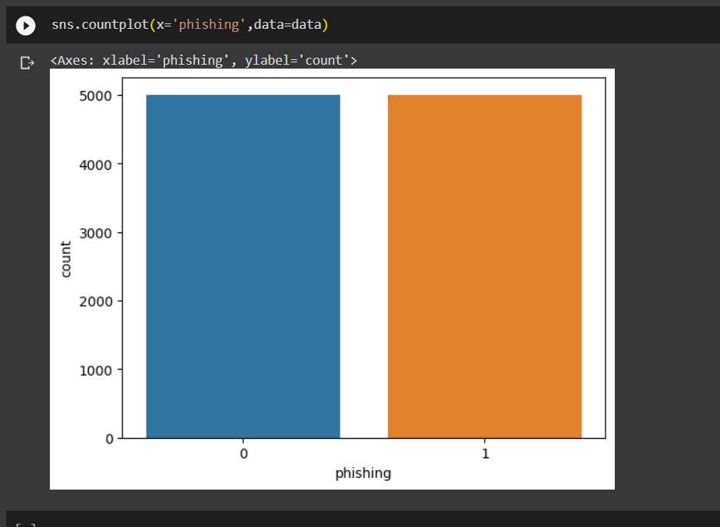
The dataset used in this project was obtained from the following source: [GitHub - Phishing_Dataset](https://github.com/Charlie-logan/Phishing_Dataset/blob/890f9c308f24a44b8129774e77e72ff145113d1c/phishing.csv)
The were 10,000 instances in total with a 72.1% baseline.

Slide 18
PRE-PROCESSING

Slide 19
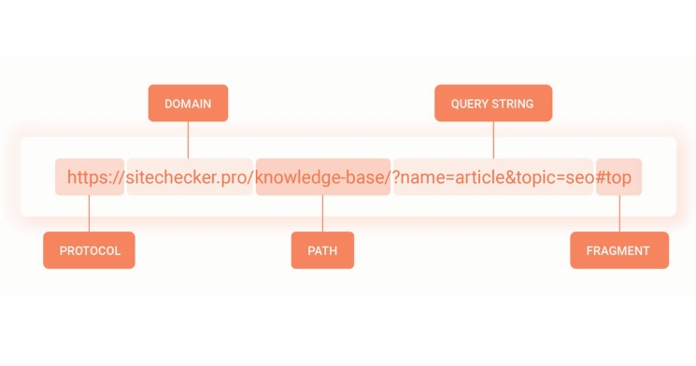
Feature Extraction
Using a function from urllib library, protocol, domain, path, query, and fragment were extracted from the URL and respective columns were created. The protocol column was dropped as more sophisticated phishing URLs are
labeled secure with https://.

Slide 20
Feature Extraction
Length of URL, domain, path, query, and fragment are extracted.
Quantity of specific characters in URL, domain, path, query, and fragment are extracted. These characters include:
- = ! +
. @ ~ *
? & , #
$
%
space
25 Total Features Used in Model

Slide 21
Experimental Setup

Slide 22
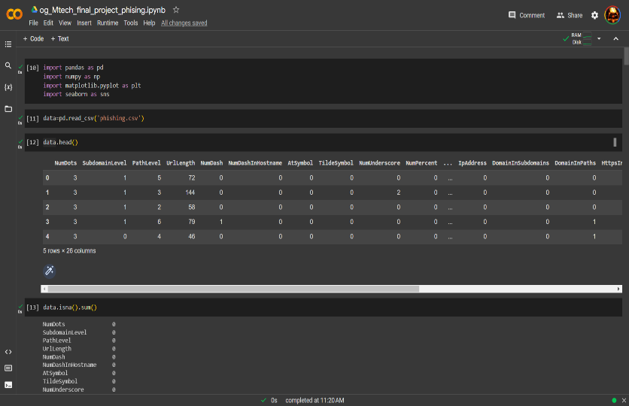
Dataset Division:
- The initial step in the experimental setup is to load the dataset using `pd.read_csv('phishing.csv')`.
- The dataset is then examined using various methods like `data.head()`, `data.isna().sum()`, `data.describe()`, and `data.groupby('phishing').mean()` to get a better understanding of the data.
- The count of each class in the target variable is visualized using `sns.countplot(x='phishing', data=data)`.
Data Preprocessing:
- The dataset is divided into features and the target variable using `x = data.drop(columns='phishing', axis=1)` and `y = data['phishing']`.
- Next, the dataset is split into training and testing sets using `train_test_split(x, y, test_size=0.2)`. This creates `x_train`, `x_test`, `y_train`, and `y_test` datasets.

Slide 23
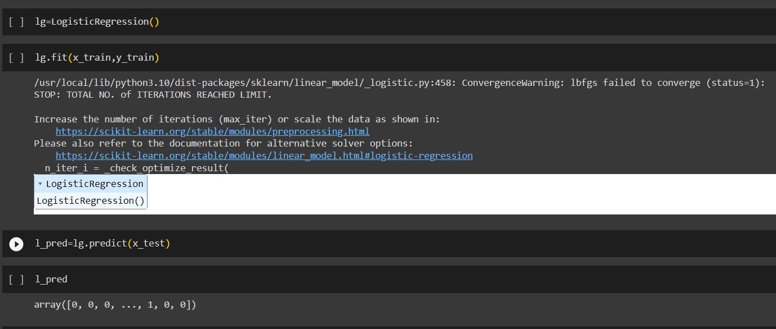
Model Training and Evaluation:
- Logistic Regression, Decision Tree, Random Forest, and k-nearest neighbors classifiers are trained and evaluated.
- Logistic Regression: The model is created using `LogisticRegression()` and trained using `lg.fit(x_train, y_train)`. Predictions are made on the test set using `lg.predict(x_test)`.
- Decision Tree: The model is created using `tree.DecisionTreeClassifier()` and trained using `dt.fit(x_train, y_train)`. Predictions are made on the test set using `dt.predict(x_test)`.
- Random Forest: The model is created using `RandomForestClassifier()` and trained using `rf.fit(x_train, y_train)`. Predictions are made on the test set using `rf.predict(x_test)`.
- k-nearest neighbors: The model is created using `KNeighborsClassifier()` and trained using `neigh.fit(x_train, y_train)`. Predictions are made on the test set using `neigh.predict(x_test)`.
- The accuracy score for each model is calculated using `accuracy_score(y_test, predicted_values)`.

Slide 24
MODEL
SELECTION &
EVALUATION

Slide 25
Models Tested
- Logistic Regression
- Decision Tree Classifier
- K-Nearest Neighbors Classifier
- Random Forest Classifier
Baseline: 72.1%
Accuracy Score , Confusion matrix and classification report tools were used to optimize the highest-scoring result.
Once the best model was determined, we started using it with our own customized based url and depending on the inputs it is showing a url is phishing or legitimate.

Slide 26
Model Selection
TRAINING
S C O R E
94.8%
97.6%
97.9%
97.0%
TESTING
S C O R E
84.2%
85.6%
83.4%
90.2%
USED FOR
DEPLOYMENT
MODEL
k-Nearest Neighbors
Decision Trees
Logistic Regression
Random Forest

Slide 27
Model Evaluation
Performance Metrics:
- The performance metrics used for evaluation include:
- Confusion Matrix: The confusion matrix is calculated using `confusion_matrix(y_test, predicted_values)` to measure the number of true positives, true negatives, false positives, and false negatives.
- Classification Report: The classification report is generated using `classification_report(y_test, predicted_values)` to display precision, recall, F1-score, and support for each class.
Model Comparison:
- The accuracy scores of the different models are stored in the `pred_compare` list.
- The names of the models are stored in the `pred_names` list.
- A bar plot is created using `plt.bar(pred_names, pred_compare)` to compare the accuracy of different models.
Feature Extraction and Prediction:
- The function `extract_features(url)` is defined to extract features from a given URL.
- Features are extracted using various URL characteristics like the number of dots, subdomain level, path level, URL length, presence of certain symbols, etc.
- The extracted features are then converted into a DataFrame named `new`.
- The `RandomForestClassifier` model is used to predict whether the given URL is a phishing site or not using `u_pred = rf.predict(new)`.
- The predicted result is stored in `u_pred[0]`.

Slide 28
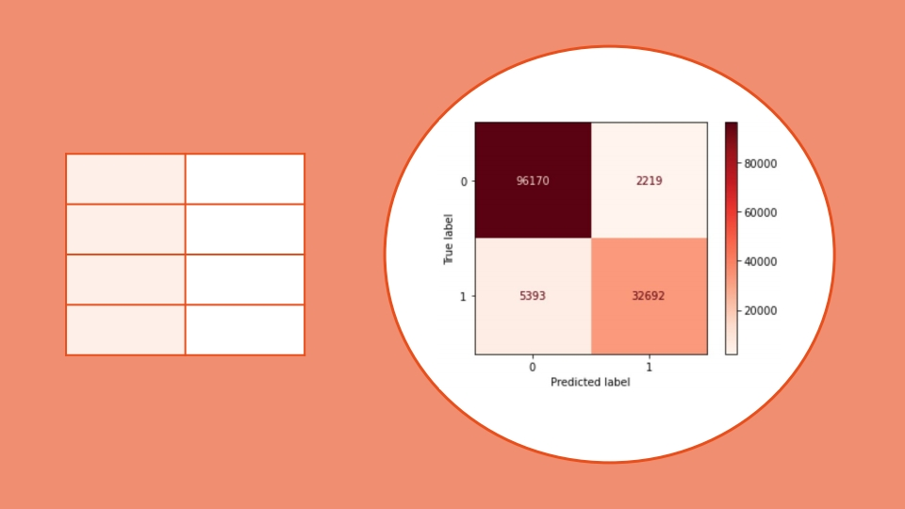
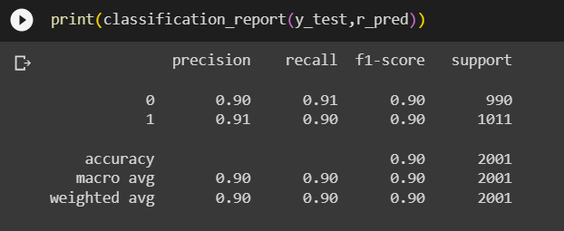
Model Evaluation
Accuracy | 90.2%
Recall | 90.0%
Fi-score | 90.0%
Precision | 90.0%

Slide 29
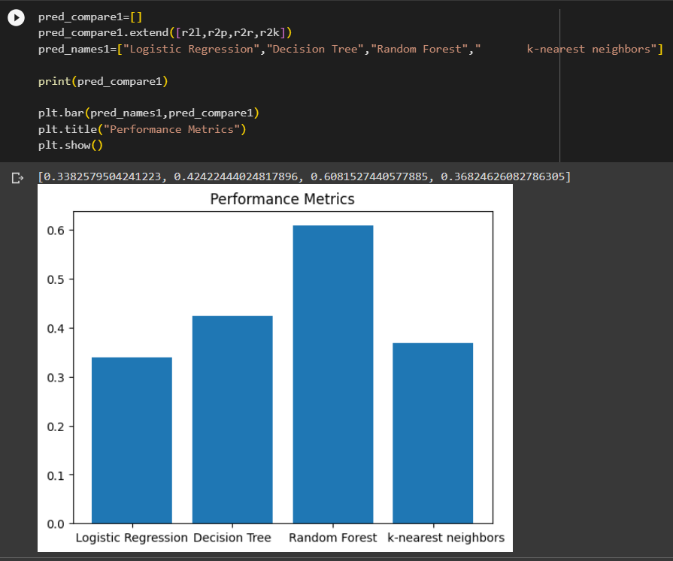
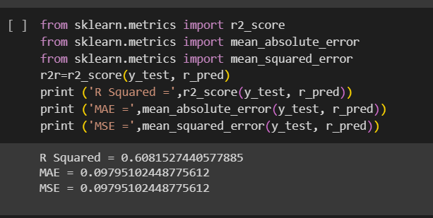
Model Evaluation

Slide 30
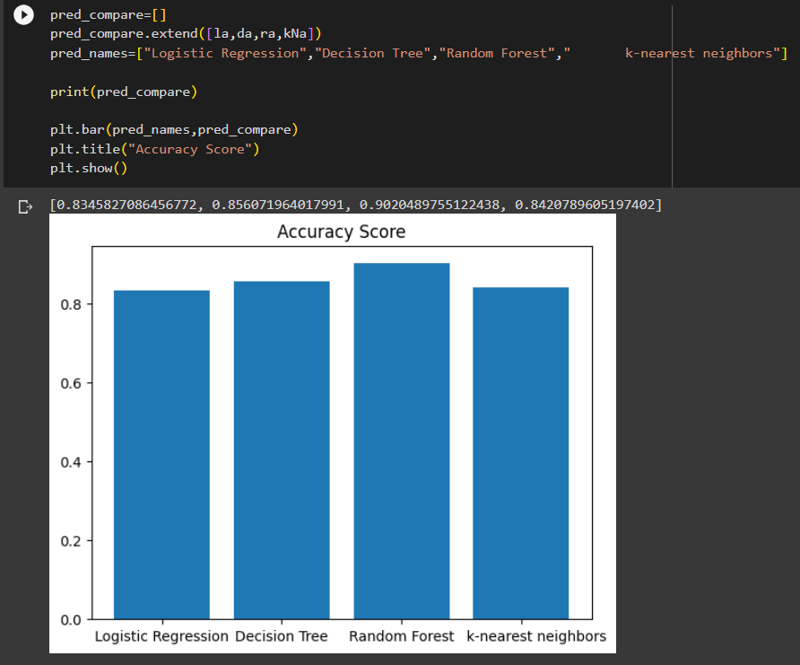
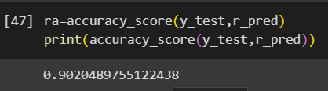
Model Evaluation

Slide 31
MODEL
TESTING

Slide 32
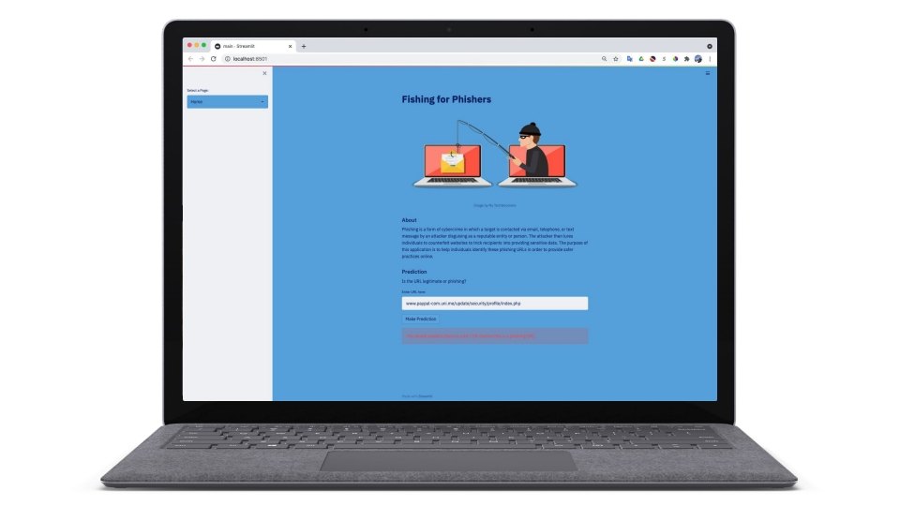
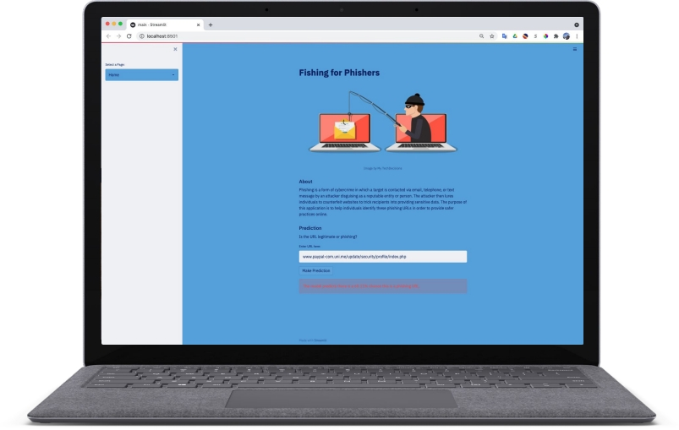
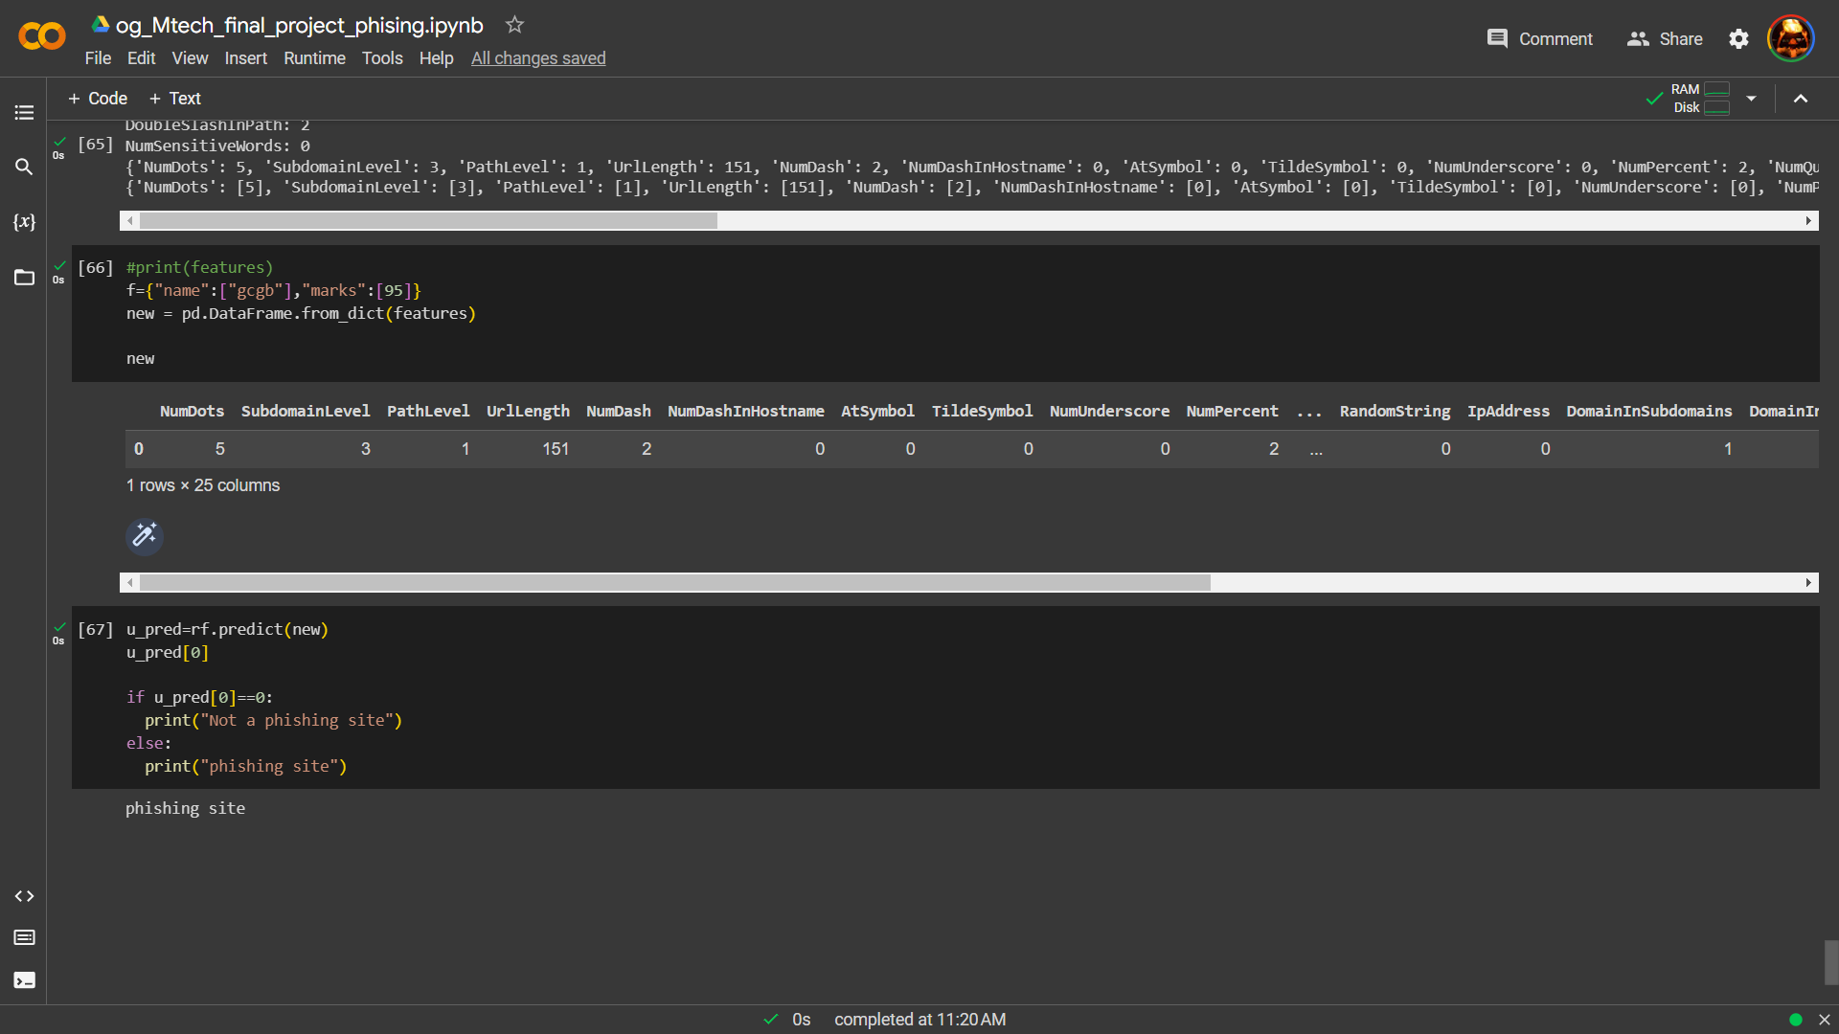

Slide 33
CONCLUSIONS

Slide 34
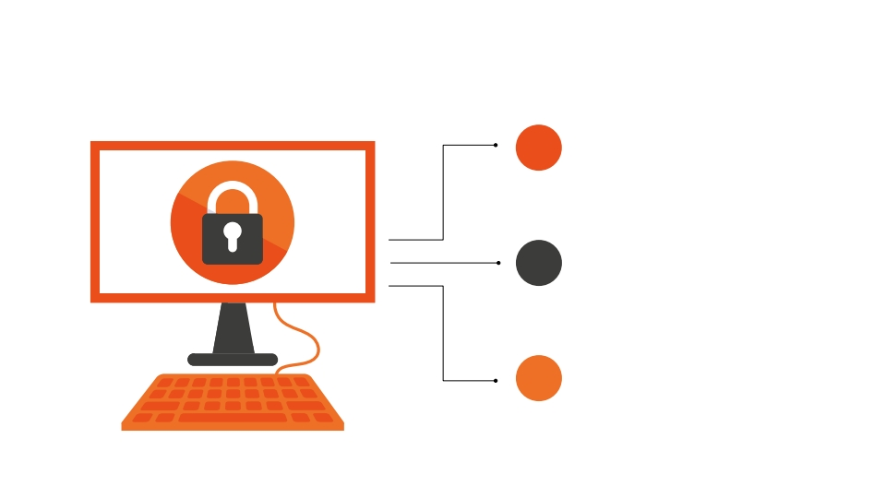
How to Avoid Phishing Attacks
STAY INFORMED
Learn about new phishing techniques that are being developed to avoid falling prey to one.
THINK BEFORE YOU CLICK
Never click on hyperlinks
without examining the hidden
URL.
UTILIZE ‘FISHING FOR PHISHERS’ When in doubt, use the ‘Fishing for
Phishers’ app to verify the authenticity of a website.
1
2
3

Slide 35

Thank you!
Any questions?

Slide 36
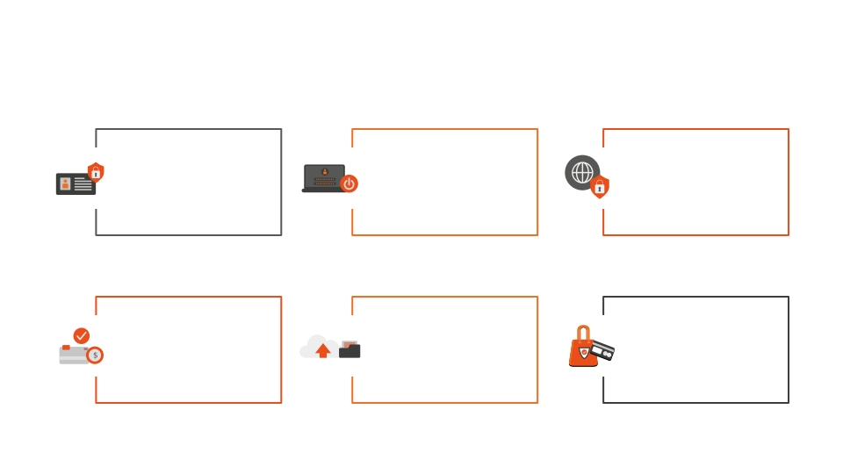
References
KnowBe4. “What Is
Phishing?” Phishing,
www.phishing.org/what-is-
phishing.
“History of Phishing.”
Cofense, 28 May 2021,
cofense.com/knowledge-ce
nter/history-of-phishing/.
“The 2021 Ponemon Cost of PHISHING Study: Proofpoint US.” Proofpoint, 19 Aug. 2021, www.proofpoint.com/us/resources/a
nalyst-reports/ponemon-cost-of-phi
shing-study.
“2021 DBIR Master's Guide.” Verizon Business,
www.verizon.com/business/res
ources/reports/dbir/2021/mast
ers-guide/.
“Phishing Statistics (Updated 2021): 50+ Important Phishing Stats.” Tessian, 17 May 2021, www.tessian.com/blog/phishing-st
atistics-2020/.
Slide Template:
slidesgo.com

